Slide 1
Weekly Update
Jorian Bruslind
Week 9

Slide 2
HyperRail Project
Current Status
Trying to get some workdays together to test the new upgrades
Bell-Everman servo belt test
PETG 3D prints
Better delrin wheel mounts
Actual PCB drivers
Wifi Control
Final projects in class have taken a huge chunk of time

Slide 3
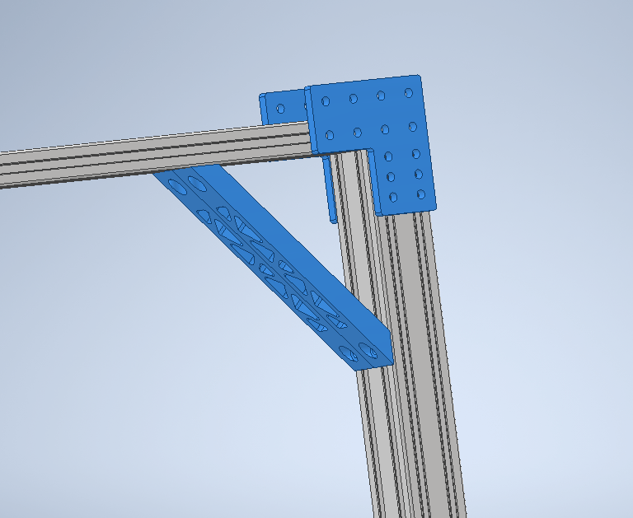
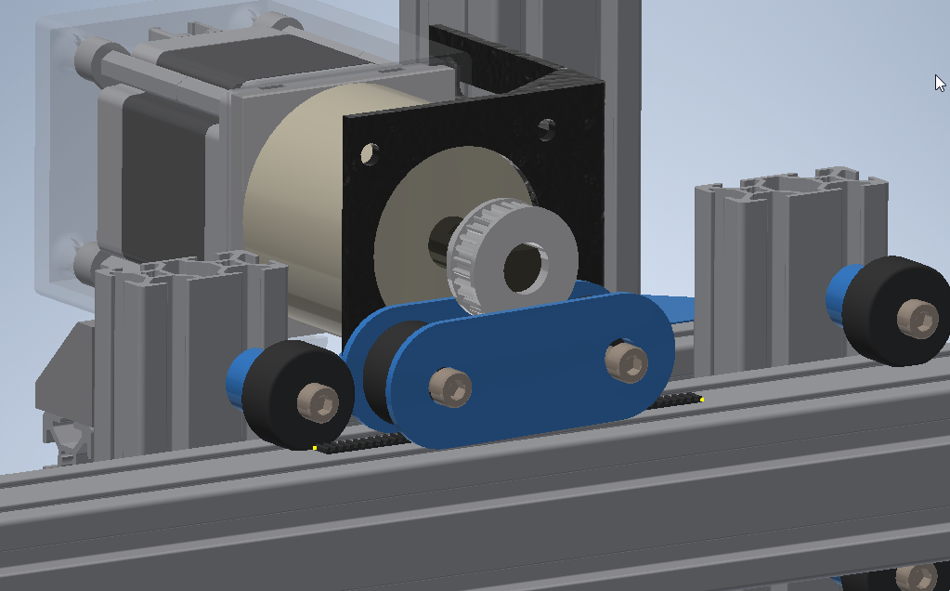
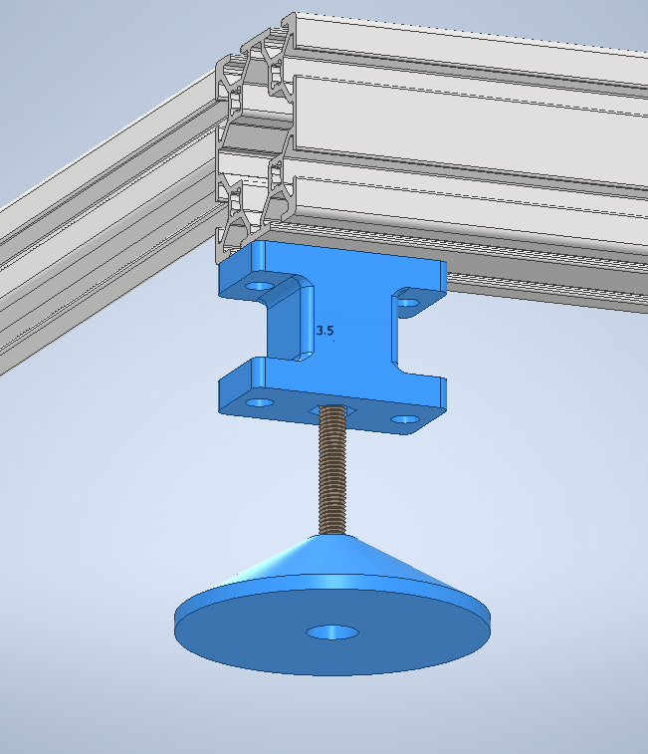
Current Status

Slide 4
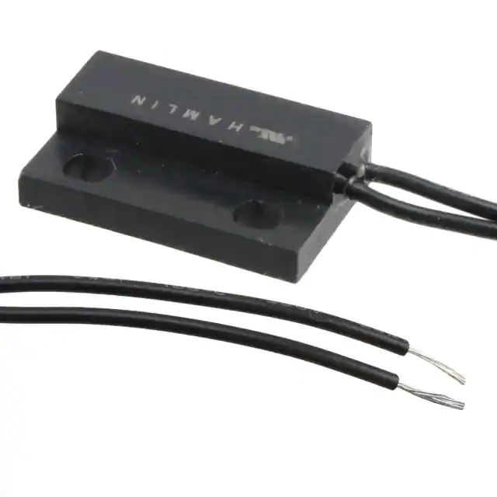
Project Work
Not much else going on, need to test everything before improving
Working on creating a web site GUI for controls (HTML / ROS based)
ROS JS calls through HTML JS, most likely running on some RPI or SBC
First iteration will have some basic controls and system feedback (states, location, etc)
Integrate Magnetic Limit Switches into design
Just need some mounting platforms and wiring
Other wiring parts need to be planned for
ESTOP
Joystick control
Fuses / Protection

Slide 5
My Plan
Design and purchase a main housing for electronics w/ ESTOP and auxiliary control
Extensive stress tests with motors to make sure nothing will go completely wrong in the field (random failures, mechanical errors).
Schedule Summer project credits with Calvin

